Slide 1
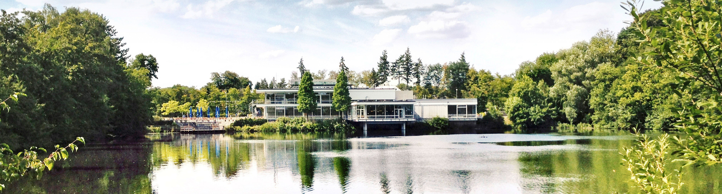
Quantum computing for Earth Observation
M2GARSS 2024 - Tutorial
April 15, 2024 Amer Delilbasic, Gabriele Cavallaro

Slide 2
Driving questions
What is quantum computing?
Why the quantum computing hype?
How can Earth observation benefit from quantum computing?
Which algorithms and resources are relevant for me?

Slide 3
Tutorial structure
Quantum computing is defined according to the postulates and laws of quantum mechanics.

Slide 4
Quantum mechanics
Fundamentals
Quantum computing is defined according to the postulates and laws of quantum mechanics.
Underlying concepts:
Superposition
Quantum systems can be described as a superposition of quantum states
Measurement
Measuring the state of a quantum system affects the state of the system in a random way
Entanglement
In an entangled system, the states of the system particles are related to each other

Slide 5
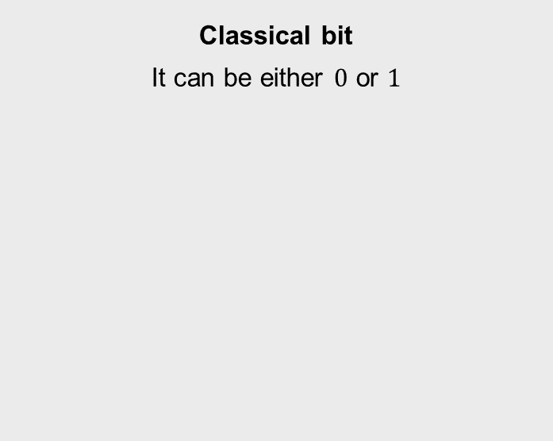
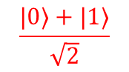
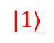
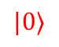
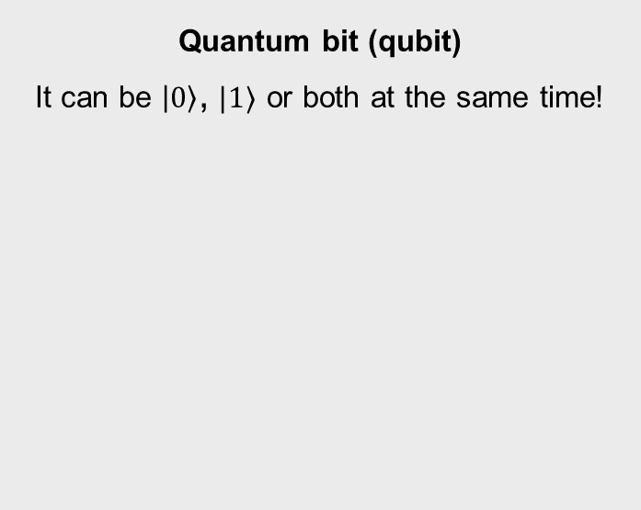
Quantum computing
Quantum information
Classical bit
It can be either $0$ or $1$
Quantum bit (qubit)
It can be $\left|0\right\rangle$, $|1⟩$ or both at the same time!
$$|0⟩$$
0 | 1 | 0 | 0 | 1 | 0 | 0 | 0
0 | 1 | 0 | 0 | 1 | 0 | 0 | 1
$$\frac{|0⟩+|1⟩}{\sqrt{2}}$$
$$|1⟩$$
Bloch sphere representation

Slide 6

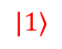
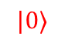
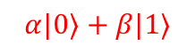
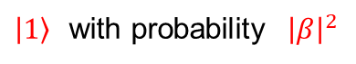
Quantum computing
Qubit measurement
$$|0⟩$$
$|0⟩$ with probability ${\left|α\right|}^{2}$
measurement
$$α|0⟩+β|1⟩$$
$\left|1\right\rangle$ with probability ${\left|β\right|}^{2}$
$$|1⟩$$
Measuring a qubit leads to a random result and affects the qubit irreversibly.
The original state is lost, and no copies can be made (no-cloning theorem).

Slide 7
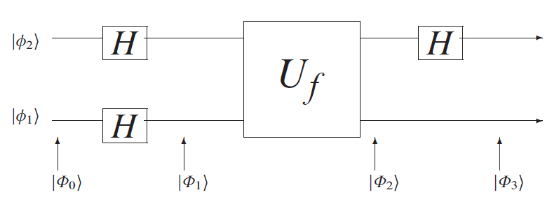
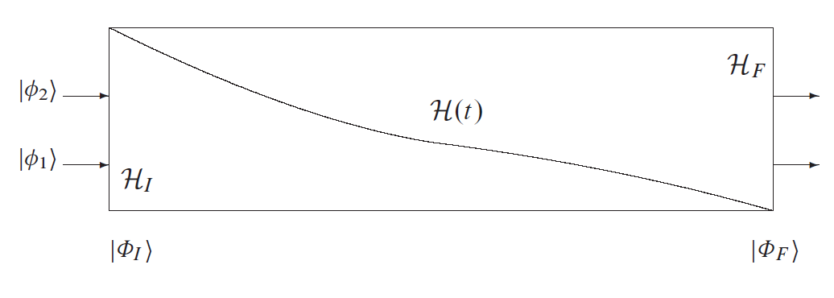
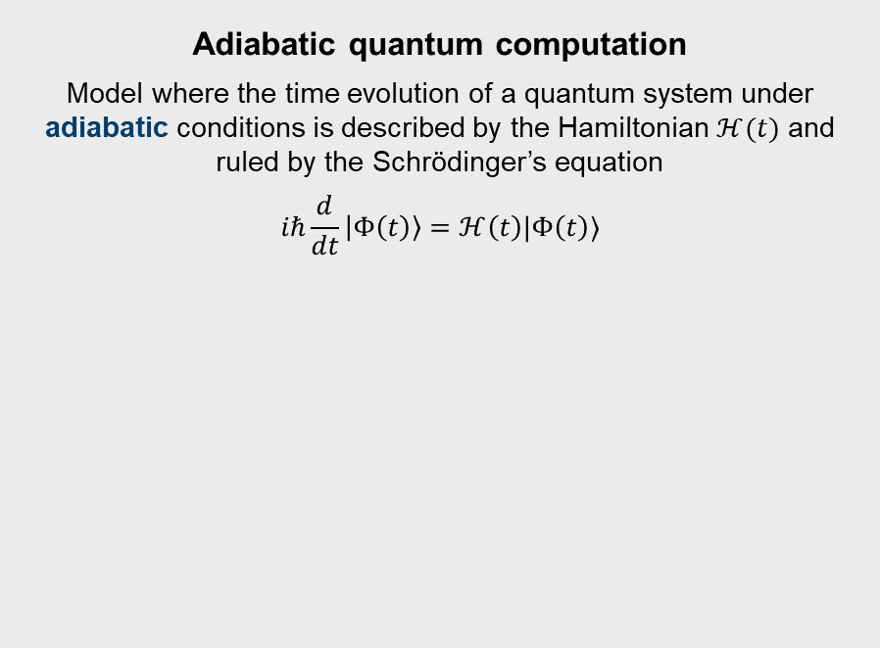
Quantum computing
Two universal quantum computational models
Quantum circuit model
Model where quantum gates and measurements are applied to qubits
Adiabatic quantum computation
Model where the time evolution of a quantum system under adiabatic conditions is described by the Hamiltonian $ℋ(t)$ and ruled by the Schrödinger’s equation
$$iℏ\frac{d}{dt}\left|Φ\left(t\right)\right\rangle =ℋ\left(t\right)|Φ\left(t\right)⟩$$
Catherine C. McGeoch, Adiabatic Quantum Computation and Quantum Annealing: Theory and Practice , Morgan & Claypool, 2014.

Slide 8
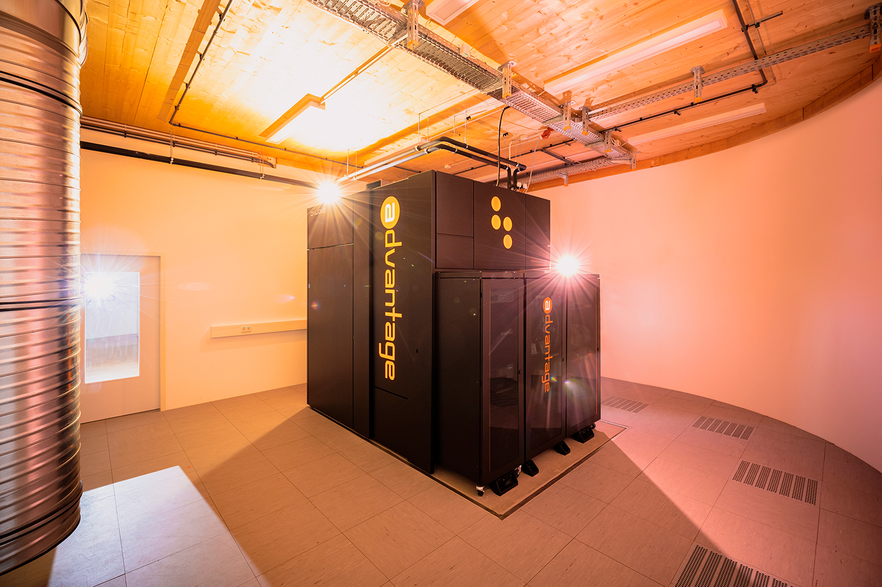
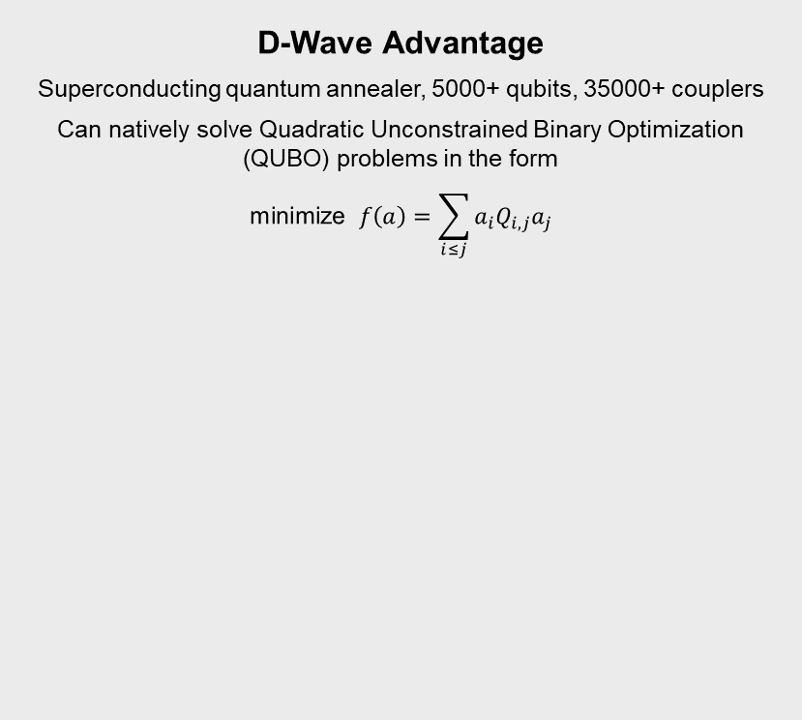
Quantum computing
Quantum annealing
D-Wave Advantage
Superconducting quantum annealer, 5000+ qubits, 35000+ couplers
Can natively solve Quadratic Unconstrained Binary Optimization (QUBO) problems in the form
$$\text{minimize} f\left(a\right)=\sum_{i≤j}{a_{i}Q_{i,j}a_{j}}$$
Special case of adiabatic quantum computation
Heuristic search for solving specific optimization problems
Realistic requirements, thus easier to implement
https://www.fz-juelich.de/en/ias/jsc/systems/quantum-computing/juniq-facility
JUPSI, a D-Wave Advantage quantum annealer hosted at FZJ

Slide 9
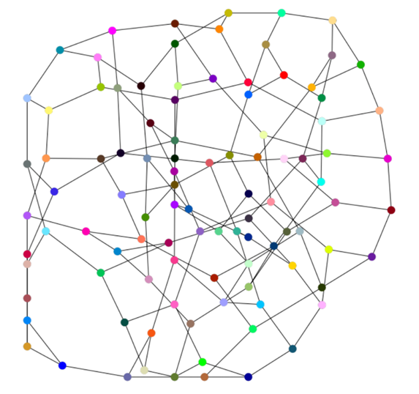
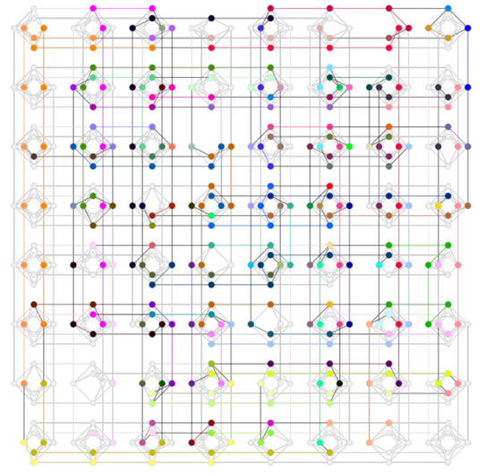
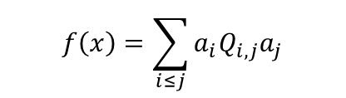
Quantum computing
QUBO with D-Wave Advantage
embedding
QUBO graph
Hardware graph
$$f\left(x\right)=\sum_{i≤j}{a_{i}Q_{i,j}a_{j}}$$

Slide 10
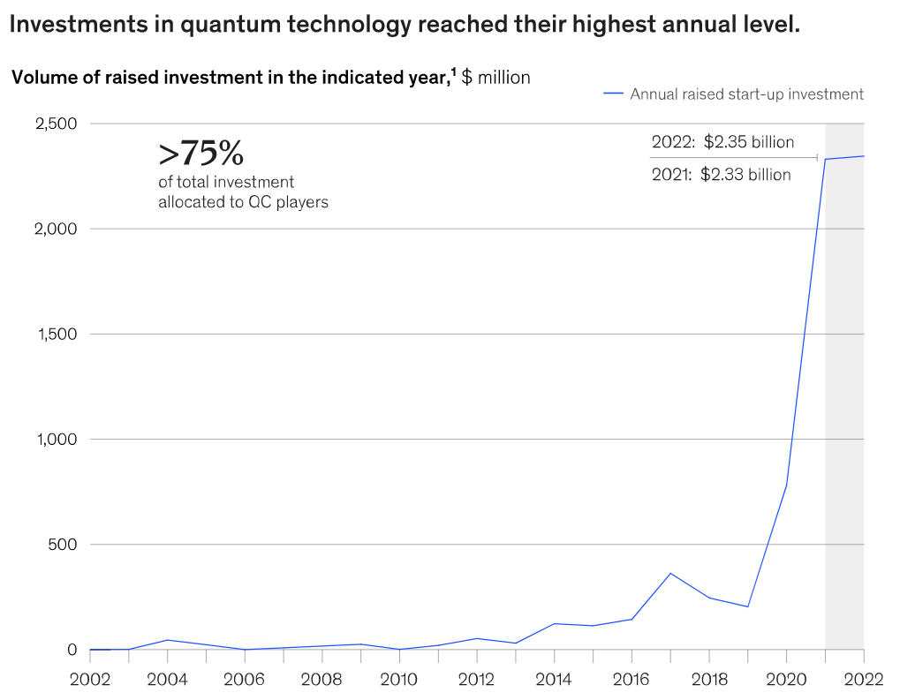
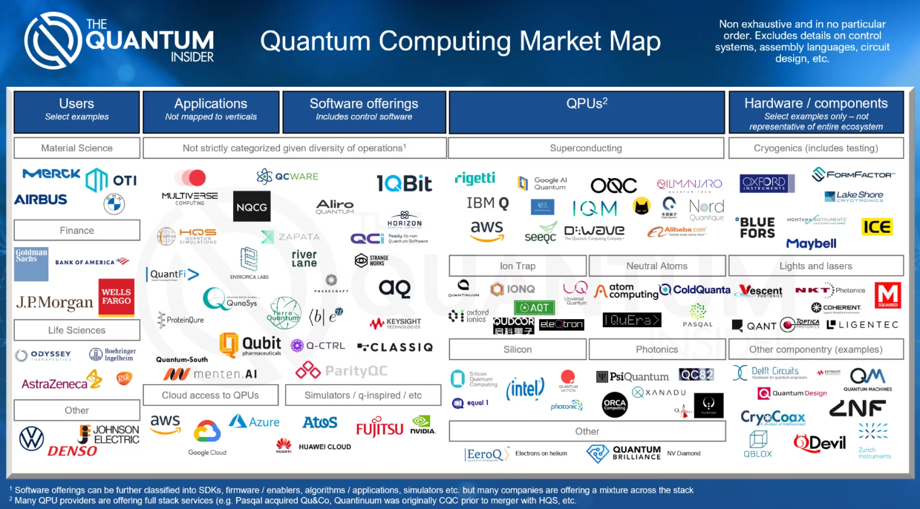
The quantum computing landscape
The quantum computing landscape
https://thequantuminsider.com/2022/05/09/quantum-computing-market-map-and-data-2022/
https://www.mckinsey.com/capabilities/mckinsey-digital/our-insights/quantum-technology-sees-record-investments-progress-on-talent-gap

Slide 11
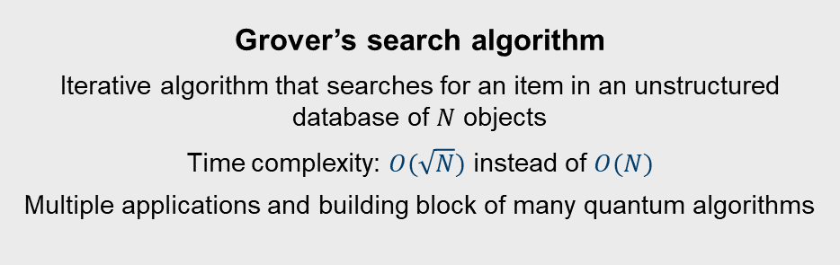
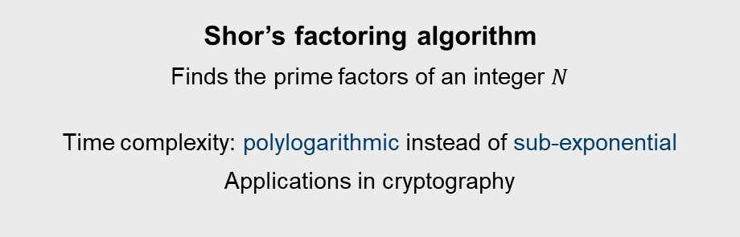
Achieving quantum advantage
The principles of quantum computing can provide a computational advantage compared to classical computing.
Celebrated examples of quantum advantage:
Grover’s search algorithm
Iterative algorithm that searches for an item in an unstructured database of $N$ objects
Time complexity: $O(\sqrt{N})$ instead of $O(N)$
Multiple applications and building block of many quantum algorithms
Shor’s factoring algorithm
Finds the prime factors of an integer $N$
Time complexity: polylogarithmic instead of sub-exponential
Applications in cryptography

Slide 12
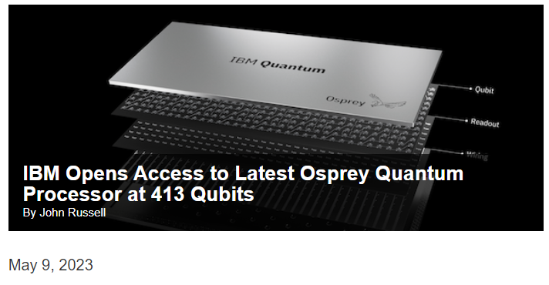
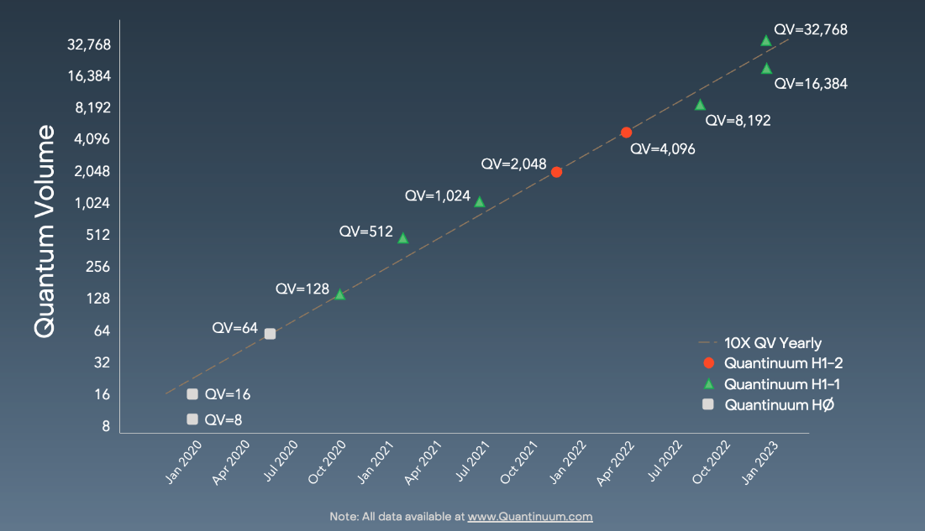
Quantum computing
Achieving quantum advantage in practice
Quantum information theory neglects physical implementation
Current state: Noisy Intermediate-Scale Quantum (NISQ) devices
Insufficient scale for a practical quantum advantage
Number of qubits
Dimension of quantum data that can be processed in a single QPU
Quantum volume
Dimension of the circuit that can be implemented with low error
https://www.hpcwire.com/2023/05/09/ibm-opens-access-to-latest-osprey-quantum-processor-at-413-qubits/
https://www.quantinuum.com/news/quantum-volume-reaches-5-digits-for-the-first-time-5-perspectives-on-what-it-means-for-quantum-computing

Slide 13
Main applications of quantum computing
TODO: improve
Quantum simulation
Initially identified by Feynman
Quantum optimization
AQC
Quantum cryptography
Shor
Quantum machine learning
Leveraging generalization power of quantum learning models
Which are relevant for Earth observation?

Slide 14
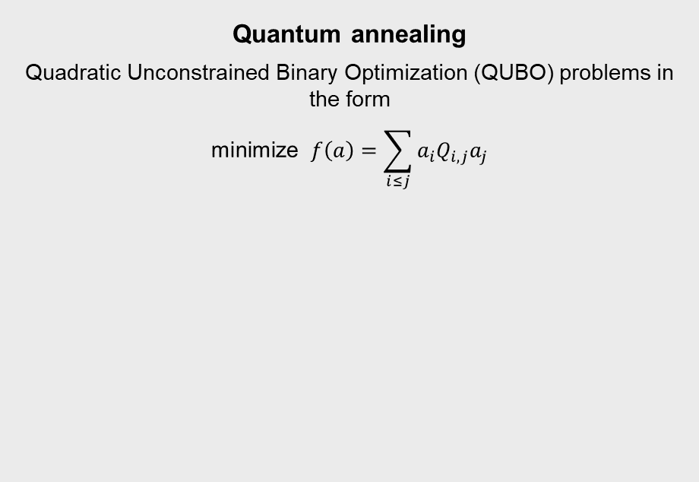
Examples of quantum optimization algorithms
TODO: add short algorithm description, mention other ones
Variational quantum algorithms
VQE, QAOA
Quantum annealing
Quadratic Unconstrained Binary Optimization (QUBO) problems in the form
$$\text{minimize} f\left(a\right)=\sum_{i≤j}{a_{i}Q_{i,j}a_{j}}$$

Slide 15
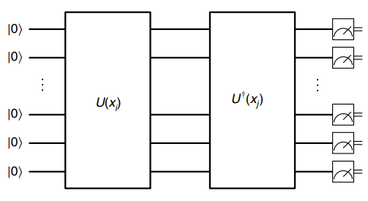
Examples of quantum machine learning algorithms
TODO: add short algorithm description, mention other ones
Quantum neural networks
…
Quantum kernels
…
Liu, Yunchao & Arunachalam, Srinivasan, Temme, Kristan. “A rigorous and robust quantum speed-up in supervised machine learning”, Nature Physics, 17, 1-5, 2019.

Slide 16
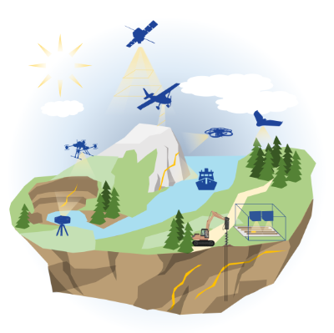
Earth observation requires increasing computing capabilities
https://www.hzdr.de/db/Cms?pOid=45916&pNid=3635

Slide 17
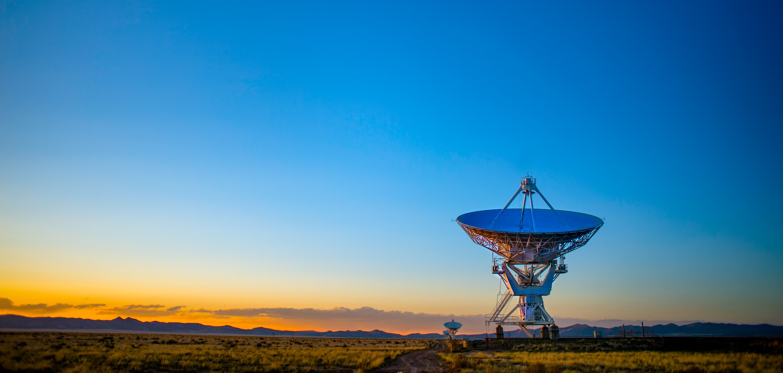



Where does quantum computing fit?
mission analysis
data acquisition
raw data processing
data analysis
Photo by Donald Giannatti on Unsplash
QC4EO Study:
https://eo4society.esa.int/projects/qc4eo-study/

Slide 18
Some use cases
TODO: add short description or images, take from following slides
Quantum optimization
Planning of EO satellite acquisitions
InSAR phase unwrapping
Bundle adjustment
Quantum machine learning
Image classification
Semantic segmentation
Variable estimation

Slide 19
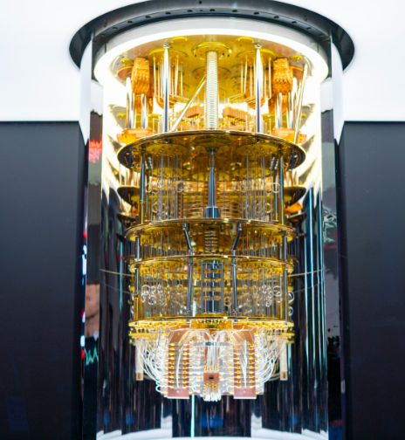
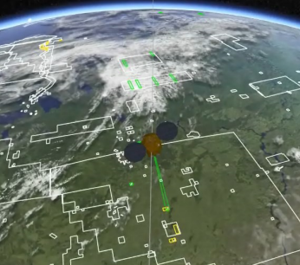
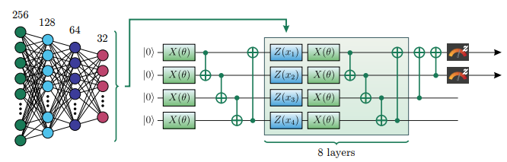
Quantum computing for Earth Observation
Existing contributions
Mission
analysis
Acquisition planning
Operational planning of satellite acquisition processes
Data acquisition
Raw data processing
Data
analysis
Rainjonneau, Serge, et al. “Quantum Algorithms applied to Satellite Mission Planning for Earth Observation” submitted to IEEE JOURNAL OF SELECTED TOPICS IN APPLIED EARTH OBSERVATIONS AND REMOTE SENSING (2023) and arXiv preprint arXiv:2302.07181v1 (2023).
Stollenwerk, Tobias, et al. "Image Acquisition Planning for Earth Observation Satellites with a Quantum Annealer." arXiv preprint arXiv:2006.09724 (2020).

Slide 20
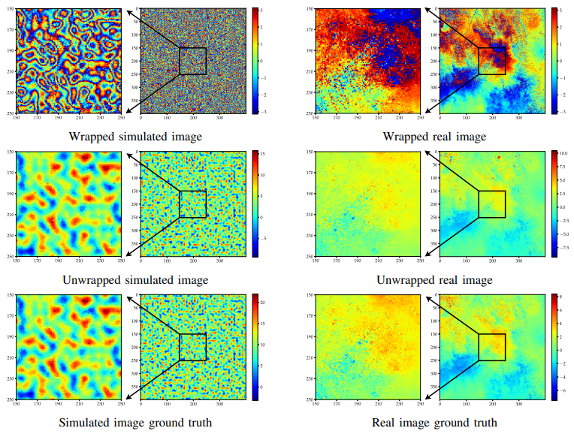
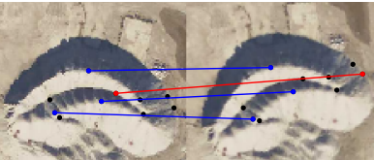
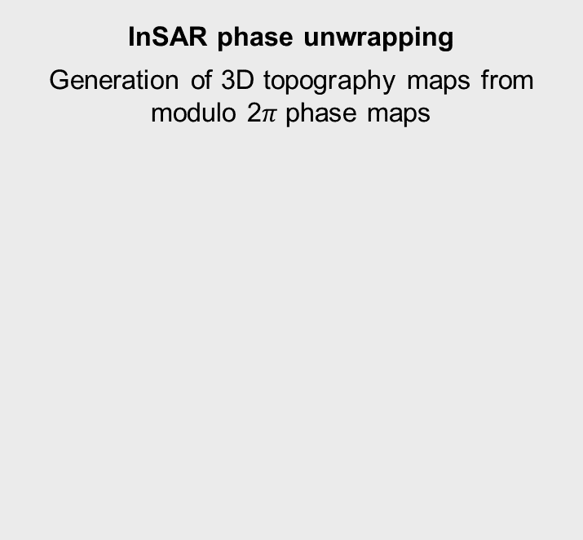
Quantum computing for Earth Observation
Existing contributions
Mission
analysis
InSAR phase unwrapping
Generation of 3D topography maps from modulo 2$π$ phase maps
Data fusion
Key point extraction and feature matching for data fusion of images taken from different points of view
Data acquisition
Raw data processing
Data
analysis
Nico Piatkowski, Thore Gerlach, Romain Hugues, Rafet Sifa, Christian Bauckhage, Frederic Barbaresco, “Towards Bundle Adjustment for Satellite Imaging via Quantum Machine Learning”, arXiv:2204.11133 (2022).
Kelany, K. A. H., Dimopoulos, N., Adolphs, C. P. J., Barabadi, B., & Baniasadi, A. (n.d.). Quantum Annealing Approaches to the Phase-Unwrapping Problem in Synthetic-Aperture Radar Imaging.

Slide 21
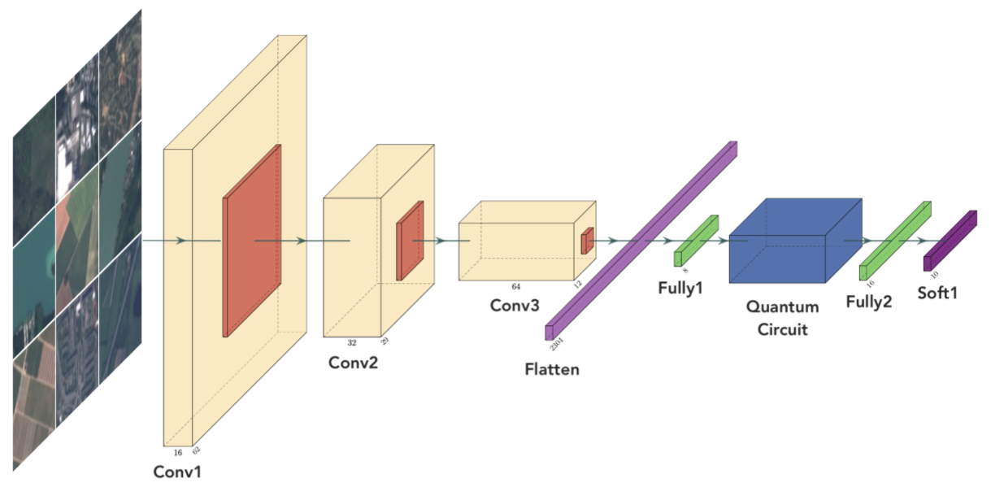
Quantum computing for Earth Observation
Existing contributions
Mission
analysis
Quantum neural networks
Quantum algorithms performing machine learning tasks applied to multispectral datasets
Quantum kernel
Quantum algorithms performing machine learning tasks applied to multispectral datasets
Data acquisition
Raw data processing
Data
analysis
A. Sebastianelli, D. A. Zaidenberg, D. Spiller, B. L. Saux, and S. L. Ullo, “On Circuit-Based Hybrid Quantum Neural Networks for Remote Sensing Imagery Classification,” IEEE Journal of Selected Topics in Applied Earth Observations and Remote Sensing, vol. 15, pp. 565–580, 2022.
Liu, Yunchao & Arunachalam, Srinivasan, Temme, Kristan. “A rigorous and robust quantum speed-up in supervised machine learning”, Nature Physics, 17, 1-5, 2019.

Slide 22
Practical examples
TODO: prepare Jupyter notebook, switch screen OR present screenshots (not intending to run anything anyway)
Acquisition planning for EO satellites
Use case for quantum optimization algorithms: QAOA, QA
Semantic segmentation of satellite images
Use case for quantum machine learning algorithms: QNN, quantum kernels

Slide 23
Acquisition planning for EO satellites
TODO: prepare Jupyter notebook, switch screen OR present screenshots (not intending to run anything anyway)
Two algorithms: QAOA, QA (see previous sections)
Tools:
QAOA
Circuit simulation with Qiskit
QA
D-Wave Ocean
mqt-satellitesolver great library for creating problem instances and testing QAOA

Slide 24
Semantic segmentation of satellite images
TODO: prepare Jupyter notebook, switch screen OR present screenshots (not intending to run anything anyway)
Two algorithms: QNN, quantum kernels (see previous sections)
Tools:
QNN, quantum kernels:
Circuit simulation with Qiskit

Slide 25
Conclusions
Summary
Something something quantum computing something something
Session “Quantum Approaches in Remote Sensing” (tomorrow, 9.30-10.30, in this room)
Quantum neural network for semantic segmentation of radar sounder images: 9.45-10.00
Quantum annealing for semantic segmentation of optical images: 10.15-10.30

